Slide 1
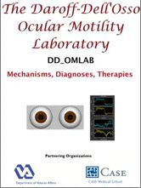


The “Slow to See” Phenomenon in Infantile Nystagmus Syndrome:
Model Prediction and Patient Data
L.F. Dell'Osso
The Daroff-Dell’Osso Ocular Motility Laboratory – Louis Stokes Cleveland Department of Veterans Affairs Medical Center and CASE Medical School, Departments of Neurology and Biomedical Engineering, Case Western Reserve University, Cleveland OH; USA

Slide 2
MODEL PREDICTIONS
Different Target Timings
Half Speed
Lt=520ms
Lt=460ms
Lt=630ms
Lt=570ms

Slide 3
RESULTS
Foveating Strategy
Small Steps
Preprogrammed Fast Phase
&
Refixation Saccade
Half Speed
Lt~600ms

